Slide 1
TEAM DETAILS
TEAM MEMBERS : DHANUSH V-AI20011
BATRICK JOSHUA G.N-AI20008
BHARATH G-AI20009
GUIDED BY : Mr. PB. ARAVIND PRASAD
DOMAIN NAME : NATURAL LANGUAGE PROCESSING

Slide 2
BASE PAPER
Paper Title : Stop words in Technical
Language Processing
Published On: June 2020
Author : Serhad Sarica , Jianxi Luo

Slide 3
MODIFIED TITLE
POS Tagger and Spell Checker with Stopwords
Identification Using NLP

Slide 4
MODIFIED ABSTRACT
Parts of Speech (POS) Tagging is a notable NLP topic that aims in assigning each word of a text the proper syntactic tag in its context of appearance .
A POS is a grammatical classification that commonly includes verbs, adjectives, adverbs, nouns, etc. DL and ML based POS taggers are being implemented as potential solutions to efficiently identify words in a given sentence across a paragraph.

Slide 5
LITERATURE SURVEY
S.No | Topic | Year On Published | Author | Algorithm | Advantage | Disadvantage
1) | Part of speech tagging: a systematic review of deep learning and machine learning approaches | 24 January 2022 | Alebachew Chiche & Betselot Yitagesu | Viterbi Algorithm | Reducing the text data size can make it more manageable and faster to process. | Loses important information by removing words that may be significant in a specific context.
2) | Professional chat application based on natural language processing | 4th June 2019 | S Karthick & R John Victor | Brill-Tagger Algorithm | Improving the performance of NLP algorithms by reducing the number of irrelevant words | The subjectivity of stop word list can affect the results of any downstream tasks.

Slide 6
S .No | Topic | Year On Published | Author | Algorithm | Advantage | Disadvantage
3) | Speech recognition using Support Vector Machines | 16 June 2020 | Samir Rustamov & Kamil Aida-zade | Support Vector Machines | Reducing the text data size can make it more manageable and faster to process. | The possibility of losing important information by removing words that may be significant in a specific context.
4) | Part-of-speech labeling for Reuters database | February 21 2019 | A.David & D.Morairu | Deep Learning (convolutional neural networks (CNN) | Improving the performance of natural language processing algorithms by reducing the number of irrelevant words that the algorithm needs to process. | Relevant stop word lists can be hard to find in some languages and so may not scale as more languages need to be processed.
5) | Part-of-Speech Tagging with Rule-Based Data Preprocessing and Transformer | 24 December 2021 | Hongwei Li & Hongyan Mao | Baum-Welch Algorithm | Improving the interpretability of the results by removing words that do not carry much meaning. | The need to maintain and update the stop word list as the language and domain evolve.

Slide 7
OBJECTIVE
The objective of this project is to increase automaticity and maintain high precision, while limiting the size of human made corpus. To accomplish the requirements of an efficient Parts of Speech [POS] tagger.
The researchers have explored the possibility of using Deep learning (DL) and Machine learning (ML) techniques. Under this big umbrella of Artificial Intelligence, both ML and DL aim was to learn meaningful information from the given big language resources

Slide 8
PROBLEM STATEMENT
Identifying POS Tagging is much more difficult when compared to matching words to their independent parts of speech via a dictionary method.
It is quite different to sense that one word has two or more meanings based on their reference and the context they are being used.
It is difficult to individually classify and assign the parts of speech for words manually. Thus new types of words keep building up in the dictionary,
POS depends on pre trained data it is not capable of scaling to newly introduced words.

Slide 9
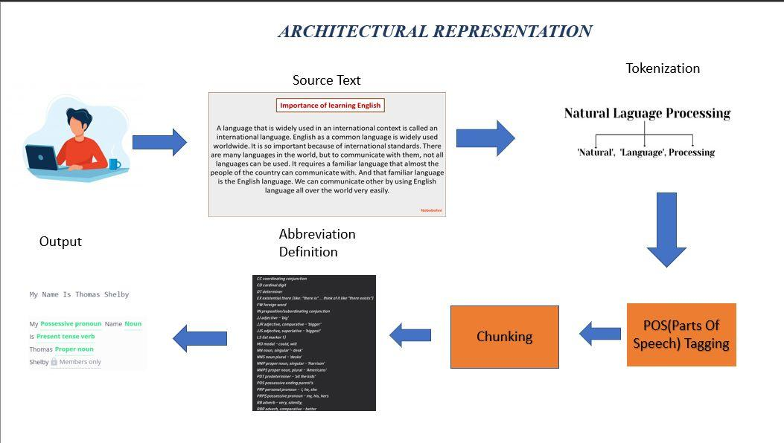
My Name Is Thomas Shelby
My (Pronoun) Name (Noun) Is (Present Tense Verb) Thomas Shelby (Proper Noun)
Fig: Over All POS Architecture

Slide 10
REQUIREMENTS
Hardware Requirements
The processor used is Intel core i5
RAM is 8GB.
Hard disk - 20GB
Software Requirements
Operating System : Windows 7 or More
Front End : Visual Studio Code For UI
Back End : Jupyter Notebook,

Slide 11
EXISTING SYSTEM
In this identifying POS Tagging is much more difficult when compared to matching words to their independent parts of speech via a dictionary method.
It is quite different to sense that one word has two or more meanings based on their reference and the context they are being used. It is difficult to individually classify and assign the parts of speech for words manually.
Algorithm Used : SVM(Support Vector Machine)

Slide 12
DISADVANTAGES OF
EXISTING SYSTEM
Since The System Uses Pre-Trained Data It Can’t Able To Identify New Words.
The Existing System Needs Frequent Updates And Maintain The Stop-words List That Requires Man-Made Effort To Do It.
Not Able To Identify The Homogeneous Words ie) like Bass-Base.

Slide 13
PROPOSED SYSTEM
The objective of this paper is to increase automaticity and maintain high precision, while limiting the size of human made corpus. In our current work we approach the task of POS tagging as an optimization problem. Thereafter two new approaches based on the principles of single objective optimization and multi-objective optimization are proposed for POS tagging.
In this proposed system we are using an algorithms are
Multinominal naive bayes
Brill tagger algorithm

Slide 14
ADVANTAGES OF
PROPOSED SYSTEM
Here, We Uses POS Tagger As An Optimization Solution Like it’s a Key Card To Overcome The Existing Problem.
This System Has Updated Libraries So It Can Provide A Solution For New Words .
The Major Advantage Of Using This System That It Can Able To Word Sense The Meaning Of The Context.

Slide 15
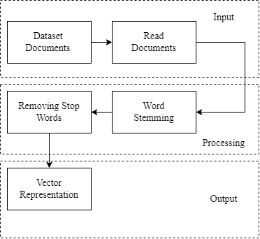
DATA FLOW DIAGRAM
Fig: Flow Diagram

Slide 16
ALGORITHM DESIGN
HIDDEN MARKOV MODEL
Viterbi Algorithm
TRANSFORMATION MODEL
Brill-Tagger Algorithm
ALGORITHM DESIGN
NLTK MODEL
Tokenization
Stemming
CNN MODEL
SpaCy Algorithm
Fig: Work Flow of Algorithm Model

Slide 17
MODULES SPLIT UP
TEXT MODULES
NLTK MODULES
TOKENIZATION
POS TAGGING
MODULES
GRAMMATICAL DISPLAY MODULES
Fig: Modules Split Up

Slide 18
TEXT MODULES
Word Embeddings: Word embedding modules represent words or phrases as dense numerical vectors in a continuous vector space. They capture semantic relationships between words, enabling algorithms to understand the meaning and context of words in a text.
Language Modeling: Language modeling modules are trained to predict the probability of the next word in a sequence given the previous words. They are used for tasks such as auto-completion, machine translation, and speech recognition.

Slide 19
TOKENIZATION
Stemming and lemmatization: NLTK offers modules for stemming and lemmatization, which help reduce words to their base or root form. The library includes stemmers like the Porter stemmer (PorterStemmer) and Lancaster stemmer (LancasterStemmer), as well as lemmatizers like the WordNet lemmatizer (WordNetLemmatizer).
Named Entity Recognition (NER): NLTK provides modules for NER, enabling you to identify and extract named entities from text. It includes a pre-trained NER chunker that can be used to label named entities like persons, organizations, locations, etc.

Slide 20
POS TAGGING
Part-of-speech (POS) tagging is a fundamental task in natural language processing that involves assigning grammatical tags or labels to each word in a sentence, indicating their syntactic category or part of speech.
PRP: Personal pronoun
VBP: Verb, non-3rd person singular present
VBG: Verb, gerund or present participle
NNP: Proper noun, singular
IN: Preposition or subordinating conjunction
JJ: Adjective
NN: Noun, singular or mass
.: Punctuation mark

Slide 21
GRAMMATICAL DISPLAY MODULES
Grammar Rule-based Modules: Rule-based grammatical modules utilize handcrafted grammar rules and patterns to analyze and process text. These modules define a set of rules and patterns that describe the syntactic and grammatical structure of a language.
Grammar Induction and Machine Learning Approaches: Grammar induction involves automatically learning grammatical rules and structures from a given set of sentences. Machine learning techniques, such as statistical models, neural networks.

Slide 22
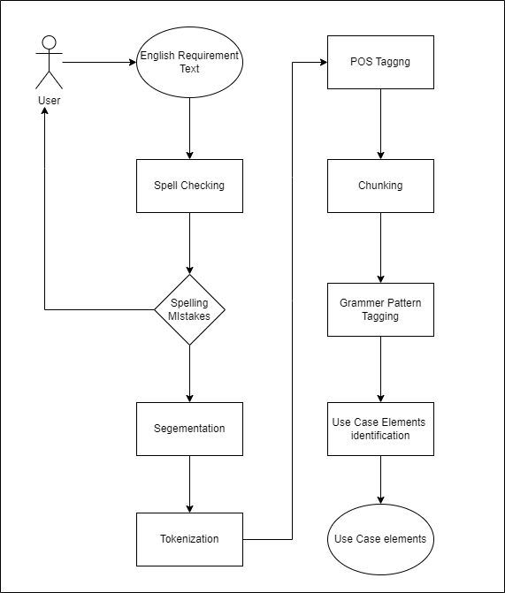
USE CASE DIAGRAM

Slide 23
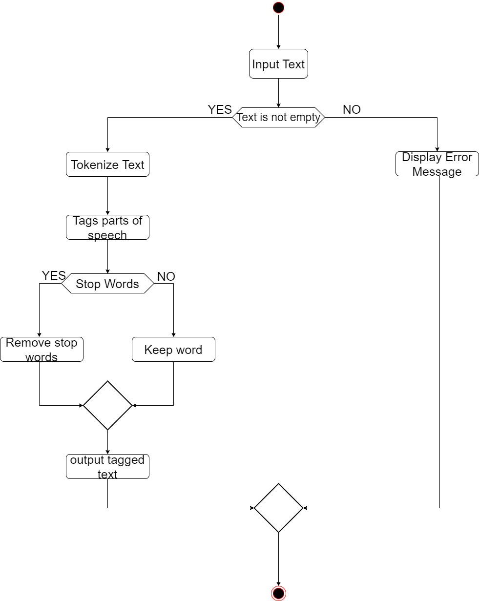
ACTIVITY DIAGRAM

Slide 24
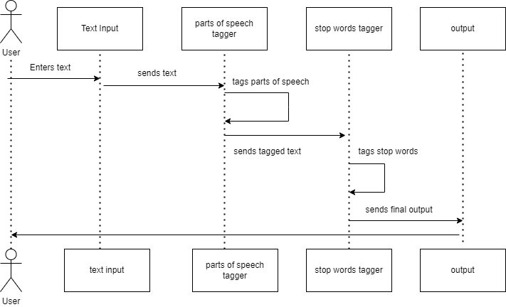
SEQUENCE DIAGRAM

Slide 25
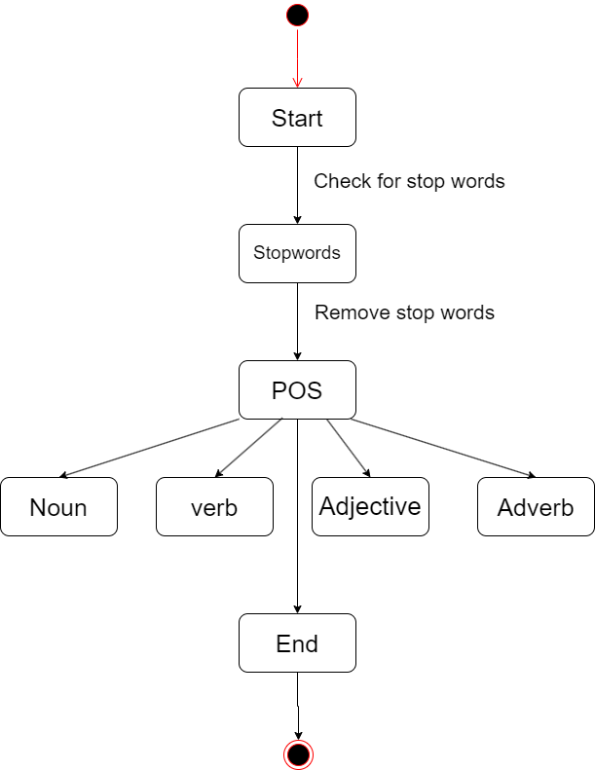
STATE DIAGRAM

Slide 26
CONCLUSION
In this paper, we propose a novel approach for POS tagging, including rule-based data preprocessing and a deep learning model based on Transformer.
During the rule-based data preprocessing, most of the tokens are tagged, which enables the model to utilize their POS tags to predict the POS tags of the remaining tokens.
Our approach combines the rule-based methods with deep learning, which is helpful for the research on POS tagging.

Slide 27
REFERENCE PAPER
Part-of-Speech Tagging with Rule-Based Data Preprocessing and Transformer- Hongwei Li & Hongyan Mao - Published in MDPI 24 December 2021
Part of speech tagging: a systematic review of deep learning and machine learning approaches -Alebachew Chiche & Betselot Yitagesu – Published in Springer open 24 January 2022
Professional chat application based on natural language processing - S Karthick & R John Victor - Published in IEEE 4 June 2019
Speech recognition using Support Vector Machines - Samir Rustamov & Kamil Aida-zade - Published in IEEE 16 June 2019
Part-of-speech labeling for Reuters database - A.David & D.Morairu - Published in IEEE 21 Feburary 2019

Slide 28
FUTURE ENHANCEMENT
Customizable Stop Word Lists: Allow users to customize the stop word list based on their specific domain or context. This flexibility would enable better filtering of irrelevant words, leading to improved text analysis and understanding.
Online and Incremental Learning: Explore online learning approaches that can continuously update and refine the POS tagging models as new data becomes available. This would allow the models to adapt to evolving language patterns and improve their performance over time.

Slide 29

THANK YOU !!!

